Slide 1
Algorithm Analysis and Design Recurrence Equation (Solving Recurrence using Master Method) Lecture – 11 and 12

Slide 2
Overview
A recurrence is a function is defined in terms of
one or more base cases, and
itself, with smaller arguments.
Examples:

Slide 3
Overview
Many technical issues:
Floors and ceilings
[Floors and ceilings can easily be removed and don’t affect the solution to the recurrence. They are better left to a discrete math course.]
Exact vs. asymptotic functions
Boundary conditions

Slide 4
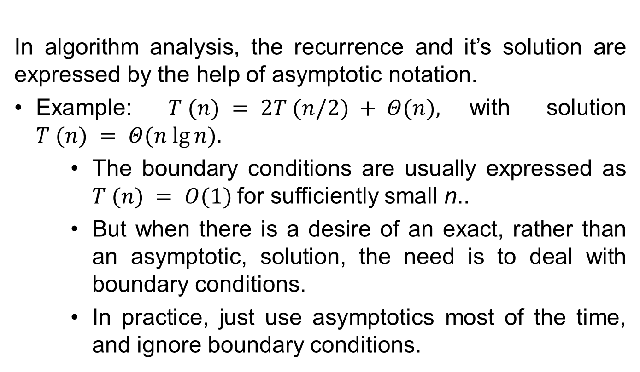
Overview
In algorithm analysis, the recurrence and it’s solution are expressed by the help of asymptotic notation.
Example: $T (n) = 2T (n/2) + Θ(n),$with solution $T (n) = Θ(n lg⁡n).$
The boundary conditions are usually expressed as $T (n) = Ο(1)$for sufficiently small n..
But when there is a desire of an exact, rather than an asymptotic, solution, the need is to deal with boundary conditions.
In practice, just use asymptotics most of the time, and ignore boundary conditions.

Slide 5
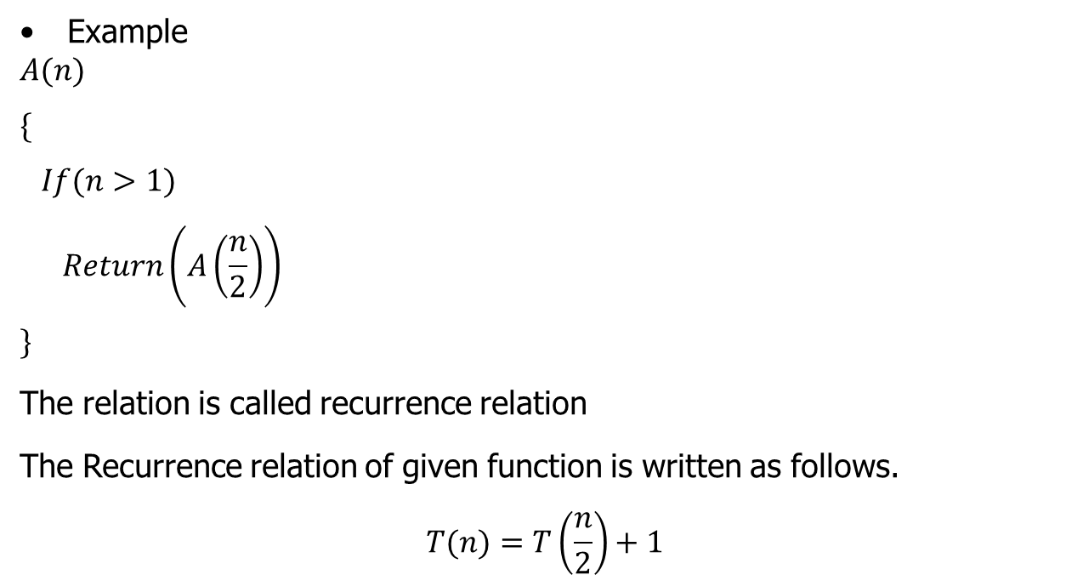
Recursive Function
Example
$$A(n)$$
$$\{$$
$$If(n>1)$$
$$Return\left(A\left(\frac{n}{2}\right)\right)$$
$$\}$$
The relation is called recurrence relation
The Recurrence relation of given function is written as follows.
$$T(n)=T\left(\frac{n}{2}\right)+1$$

Slide 6
Recursive Function
To solve the Recurrence relation the following methods are used:
Iteration method
Recursion-Tree method
Master Method
Substitution Method

Slide 7
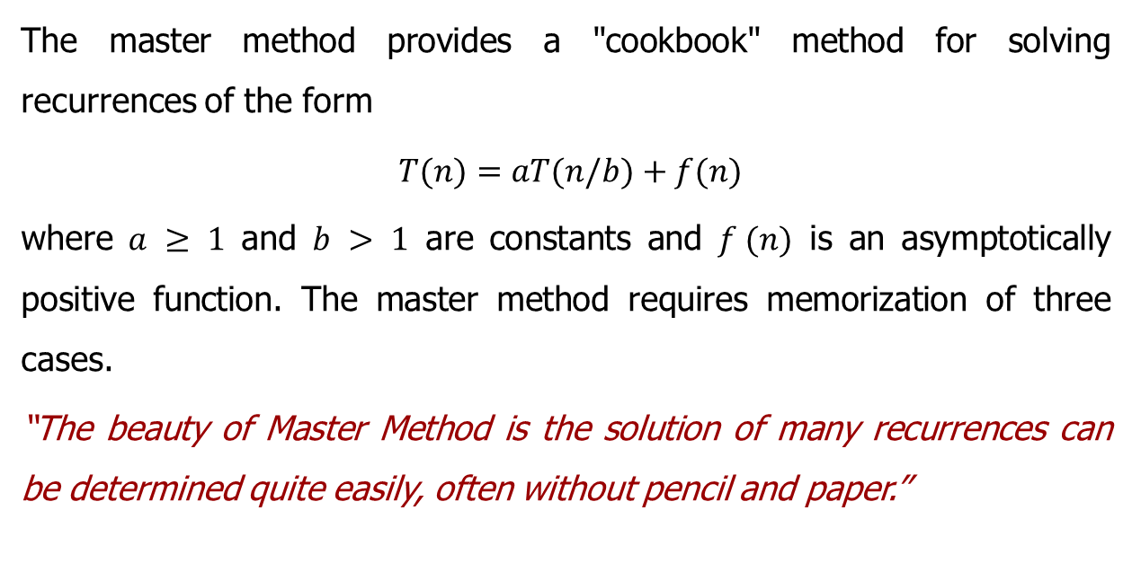
Master Method
The master method provides a "cookbook" method for solving recurrences of the form
$T(n)=aT(n/b)+f(n)$
where $a ≥ 1$ and $b > 1$ are constants and $f (n)$ is an asymptotically positive function. The master method requires memorization of three cases.
“The beauty of Master Method is the solution of many recurrences can be determined quite easily, often without pencil and paper.”

Slide 8
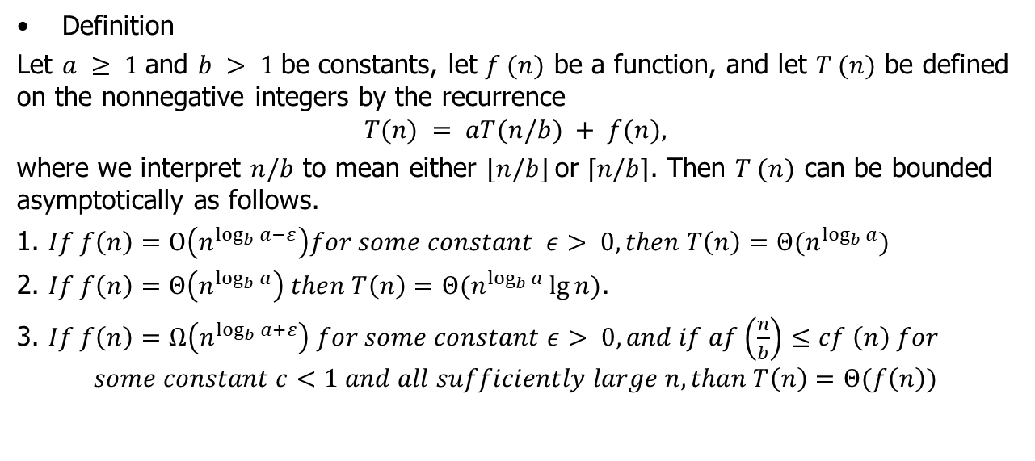
Master Method
Definition
Let $a ≥ 1$and $b > 1$be constants, let $f (n)$ be a function, and let $T (n)$ be defined on the nonnegative integers by the recurrence
$$T(n) = aT(n/b) + f(n),$$
where we interpret $n/b$ to mean either $⌊n/b⌋$or $⌈n/b⌉$. Then $T (n)$ can be bounded asymptotically as follows.
1. $If f\left(n\right)=Ο\left(n^{\log_{b}{a−}ε}\right)for some constant ε> 0, then T\left(n\right)=Θ(n^{\log_{b}{a}})$
2. $If f\left(n\right)=Θ\left(n^{\log_{b}{a}}\right) then T\left(n\right)=Θ(n^{\log_{b}{a}}\lg{n)}$.
3. $If f\left(n\right)=Ω\left(n^{\log_{b}{a+}ε}\right) for some constant ε> 0, and if af\left(\frac{n}{b}\right)≤cf \left(n\right) for$
$$some constant c<1 and all sufficiently large n, than T\left(n\right)=Θ(f\left(n\right))$$

Slide 9

Master Method
Example 1
Solve the following recurrence by using Master Method
$$T\left(n\right)=5T\left(\frac{n}{2}\right)+Θ\left(n^{2}\right)$$

Slide 10
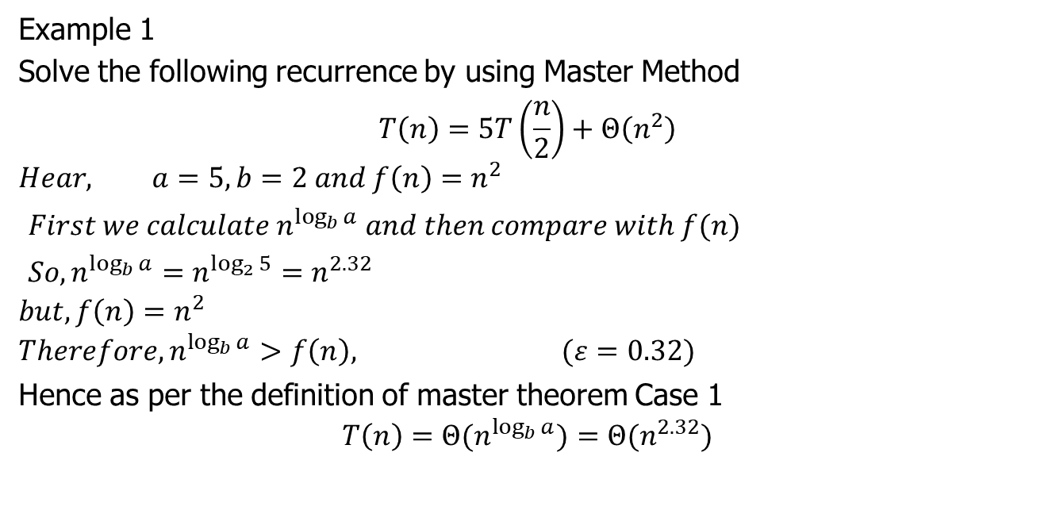
Master Method
Example 1
Solve the following recurrence by using Master Method
$$T\left(n\right)=5T\left(\frac{n}{2}\right)+Θ\left(n^{2}\right)$$
$$Hear, a=5, b=2 and f\left(n\right)=n^{2}$$
$First we calculate n^{\log_{b}{a}} and then compare with f(n)$
$So, n^{\log_{b}{a}}=n^{\log_{2}{5}}=n^{2.32}$
$$but, f\left(n\right)=n^{2}$$
$$Therefore, n^{\log_{b}{a}}>f\left(n\right), (ε=0.32)$$
Hence as per the definition of master theorem Case 1
$$T\left(n\right)={Θ(n}^{\log_{b}{a}})={Θ(n}^{2.32})$$

Slide 11

Master Method
Example 2
Solve the following recurrence by using Master Method
$$T\left(n\right)=9T\left(\frac{n}{3}\right)+Θ\left(n\right)$$

Slide 12
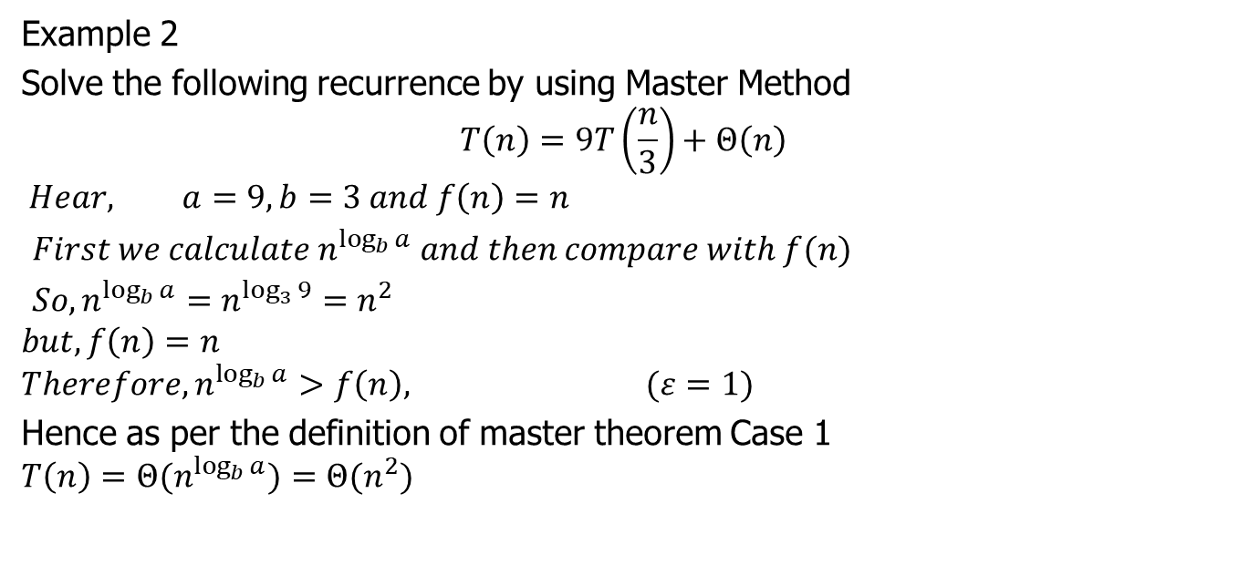
Master Method
Example 2
Solve the following recurrence by using Master Method
$$T\left(n\right)=9T\left(\frac{n}{3}\right)+Θ\left(n\right)$$
$$Hear, a=9, b=3 and f\left(n\right)=n$$
$First we calculate n^{\log_{b}{a}} and then compare with f(n)$
$So, n^{\log_{b}{a}}=n^{\log_{3}{9}}=n^{2}$
$$but, f\left(n\right)=n$$
$$Therefore, n^{\log_{b}{a}}>f\left(n\right), (ε=1)$$
Hence as per the definition of master theorem Case 1
$$T\left(n\right)={Θ(n}^{\log_{b}{a}})={Θ(n}^{2})$$

Slide 13

Master Method
Example 3
Solve the following recurrence by using Master Method
$$T\left(n\right)=T\left(\frac{2n}{3}\right)+1$$

Slide 14
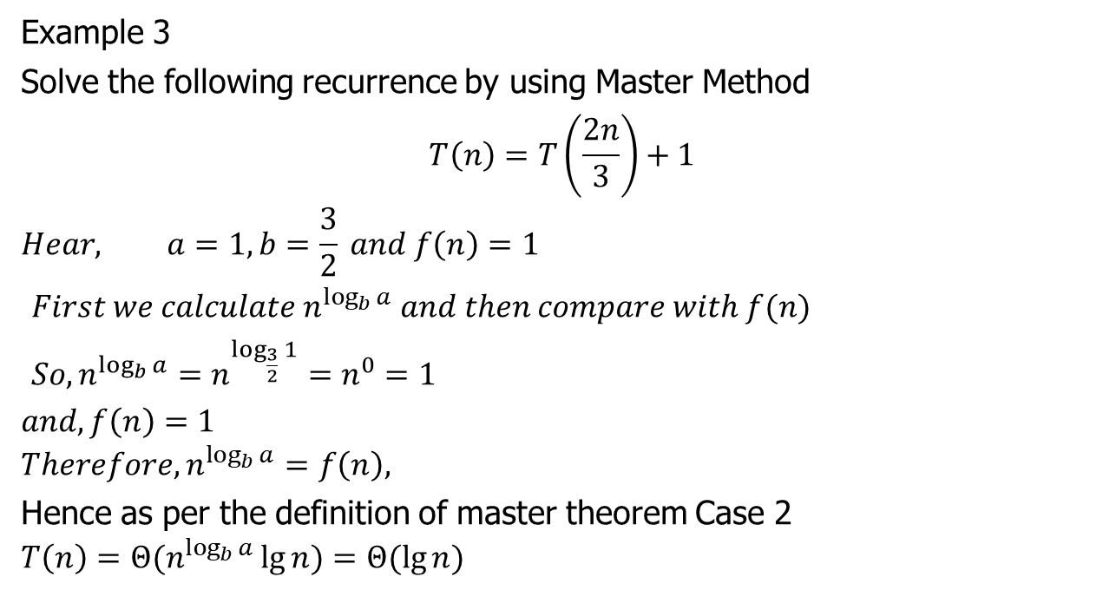
Master Method
Example 3
Solve the following recurrence by using Master Method
$$T\left(n\right)=T\left(\frac{2n}{3}\right)+1$$
$$Hear, a=1, b=\frac{3}{2} and f\left(n\right)=1$$
$First we calculate n^{\log_{b}{a}} and then compare with f(n)$
$So, n^{\log_{b}{a}}=n^{\log_{\frac{3}{2}}{1}}=n^{0}=1$
$$and, f\left(n\right)=1$$
$$Therefore, n^{\log_{b}{a}}=f\left(n\right),$$
Hence as per the definition of master theorem Case 2
$$T\left(n\right)={Θ(n}^{\log_{b}{a}}\lg{n})=Θ(\lg{n})$$

Slide 15

Master Method
Example 4
Solve the following recurrence by using Master Method
$$T\left(n\right)=3T\left(\frac{n}{4}\right)+n\lg{n}$$

Slide 16
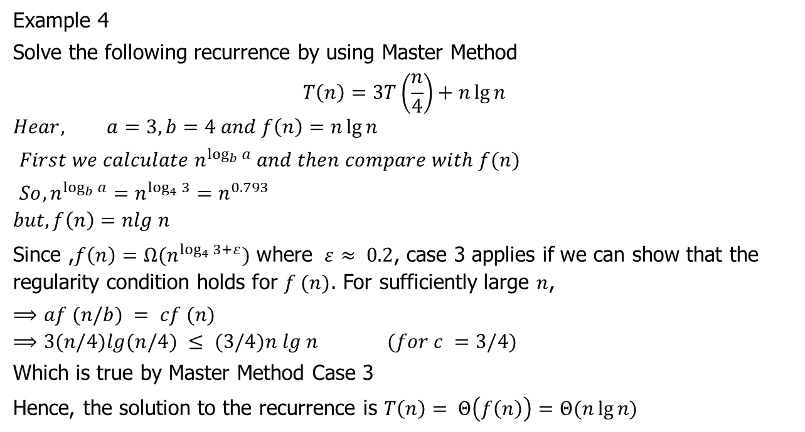
Master Method
Example 4
Solve the following recurrence by using Master Method
$$T\left(n\right)=3T\left(\frac{n}{4}\right)+n\lg{n}$$
$$Hear, a=3, b=4 and f\left(n\right)=n\lg{n}$$
$First we calculate n^{\log_{b}{a}} and then compare with f(n)$
$So, n^{\log_{b}{a}}=n^{\log_{4}{3}}=n^{0.793}$
$$but, f\left(n\right)=nlg n$$
Since ,$f\left(n\right)=Ω(n^{\log_{4}{3+ε}})$ where $­ ε≈ 0.2$, case 3 applies if we can show that the regularity condition holds for $f (n)$. For sufficiently large $n$,
$⟹af (n/b) = cf (n)$
$$⟹3(n/4)lg(n/4) ≤ (3/4)n lg n (for c =3/4)$$
Which is true by Master Method Case 3
Hence, the solution to the recurrence is $T\left(n\right)= Θ\left(f\left(n\right)\right)=Θ(n\lg{n)}$

Slide 17

Master Method
Example 5
Solve the following recurrence by using Master Method
$$T\left(n\right)=2T\left(\frac{n}{2}\right)+n\lg{n}$$

Slide 18
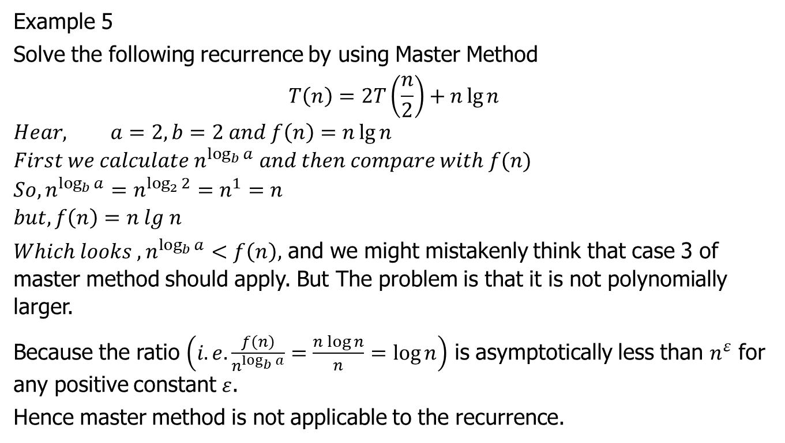
Master Method
Example 5
Solve the following recurrence by using Master Method
$$T\left(n\right)=2T\left(\frac{n}{2}\right)+n\lg{n}$$
$$Hear, a=2, b=2 and f\left(n\right)=n\lg{n}$$
$$First we calculate n^{\log_{b}{a}} and then compare with f(n)$$
$$So, n^{\log_{b}{a}}=n^{\log_{2}{2}}=n^{1}=n$$
$$but, f\left(n\right)=n lg n$$
$Which looks , n^{\log_{b}{a}}<f\left(n\right),$ and we might mistakenly think that case 3 of master method should apply. But The problem is that it is not polynomially larger.
Because the ratio $\left(i.e. \frac{f\left(n\right)}{n^{\log_{b}{a}}}=\frac{n\log{n}}{n}=\log{n}\right)$ is asymptotically less than $n^{ε}$ for any positive constant $ε$.
Hence master method is not applicable to the recurrence.

Slide 19

Master Method
Example 6
Solve the following recurrence by using Master Method
$$T\left(n\right)=4T\left(\frac{n}{2}\right)+n$$

Slide 20
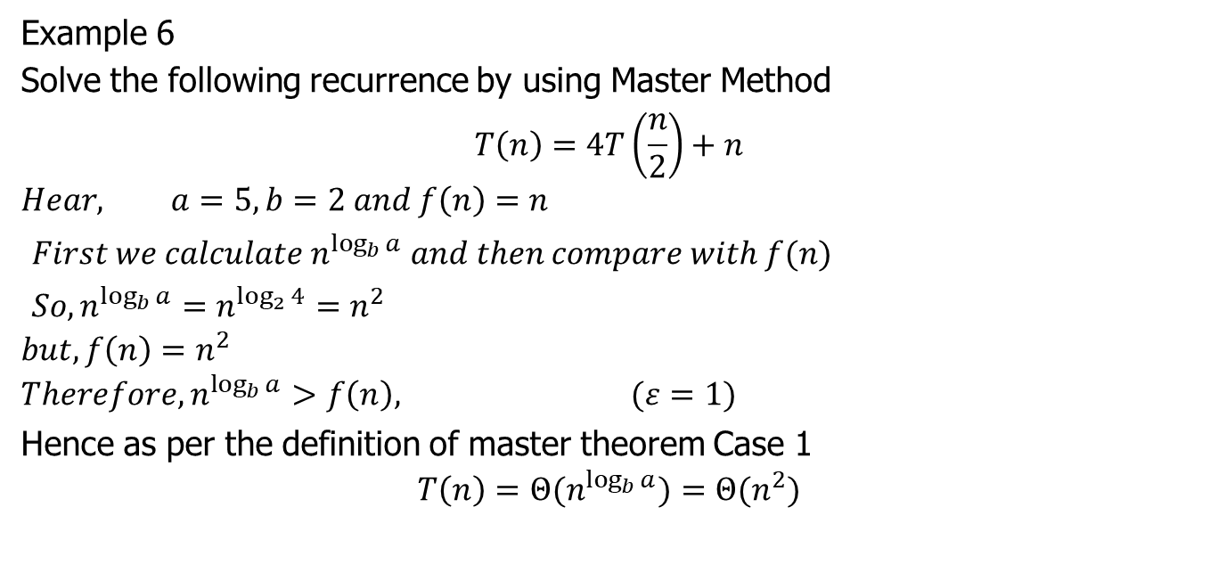
Master Method
Example 6
Solve the following recurrence by using Master Method
$$T\left(n\right)=4T\left(\frac{n}{2}\right)+n$$
$$Hear, a=5, b=2 and f\left(n\right)=n$$
$First we calculate n^{\log_{b}{a}} and then compare with f(n)$
$So, n^{\log_{b}{a}}=n^{\log_{2}{4}}=n^{2}$
$$but, f\left(n\right)=n^{2}$$
$$Therefore, n^{\log_{b}{a}}>f\left(n\right), (ε=1)$$
Hence as per the definition of master theorem Case 1
$$T\left(n\right)={Θ(n}^{\log_{b}{a}})={Θ(n}^{2})$$

Slide 21

Master Method
Example 7
Solve the following recurrence by using Master Method
$$T\left(n\right)=2T\left(\frac{n}{4}\right)+\sqrt{n}$$

Slide 22
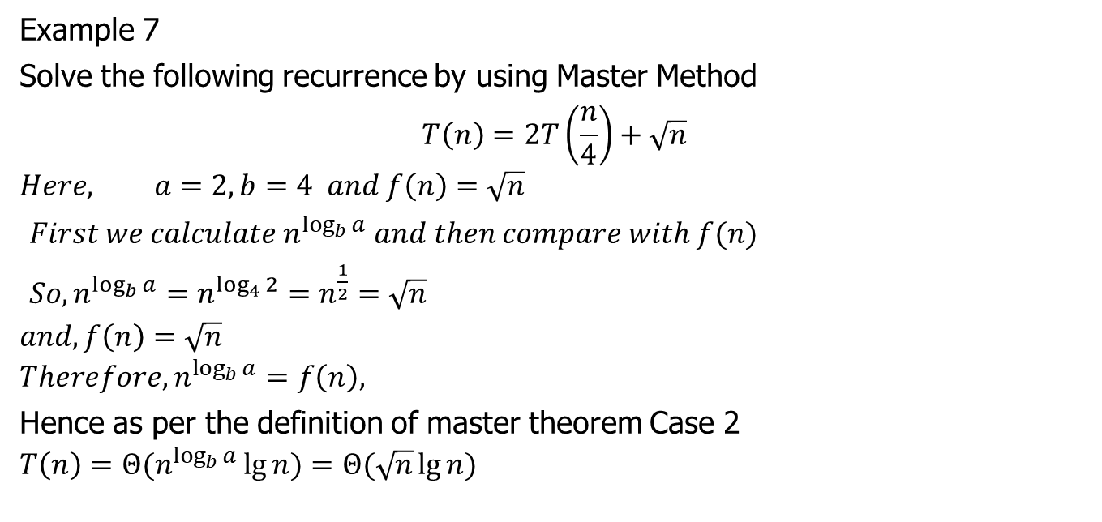
Master Method
Example 7
Solve the following recurrence by using Master Method
$$T\left(n\right)=2T\left(\frac{n}{4}\right)+\sqrt{n}$$
$$Here, a=2, b=4 and f\left(n\right)=\sqrt{n}$$
$First we calculate n^{\log_{b}{a}} and then compare with f(n)$
$So, n^{\log_{b}{a}}=n^{\log_{4}{2}}=n^{\frac{1}{2}}=\sqrt{n}$
$$and, f\left(n\right)=\sqrt{n}$$
$$Therefore, n^{\log_{b}{a}}=f\left(n\right),$$
Hence as per the definition of master theorem Case 2
$$T\left(n\right)={Θ(n}^{\log_{b}{a}}\lg{n})=Θ(\sqrt{n}\lg{n})$$

Slide 23
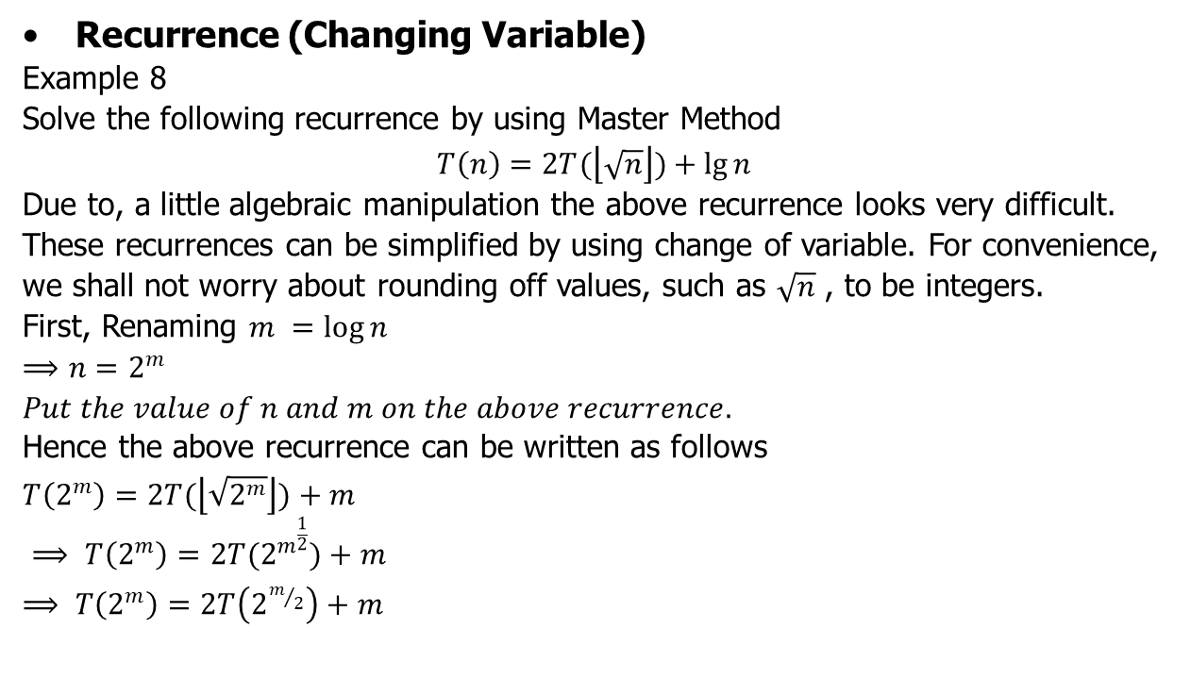
Master Method
Recurrence (Changing Variable)
Example 8
Solve the following recurrence by using Master Method
$$T\left(n\right)=2T(\left\lfloor \sqrt{n}\right\rfloor )+\lg{n}$$
Due to, a little algebraic manipulation the above recurrence looks very difficult. These recurrences can be simplified by using change of variable. For convenience, we shall not worry about rounding off values, such as $\sqrt{n}$ , to be integers.
First, Renaming $m =\log{n}$
$$⟹n=2^{m}$$
$Put the value of n and m on the above recurrence.$
Hence the above recurrence can be written as follows
$$T\left(2^{m}\right)=2T(\left\lfloor \sqrt{2^{m}}\right\rfloor )+m$$
$⟹ T\left(2^{m}\right)=2T(2^{m^{\frac{1}{2}}})+m$
$⟹ T\left(2^{m}\right)=2T\left(2^{m/2}\right)+m$

Slide 24
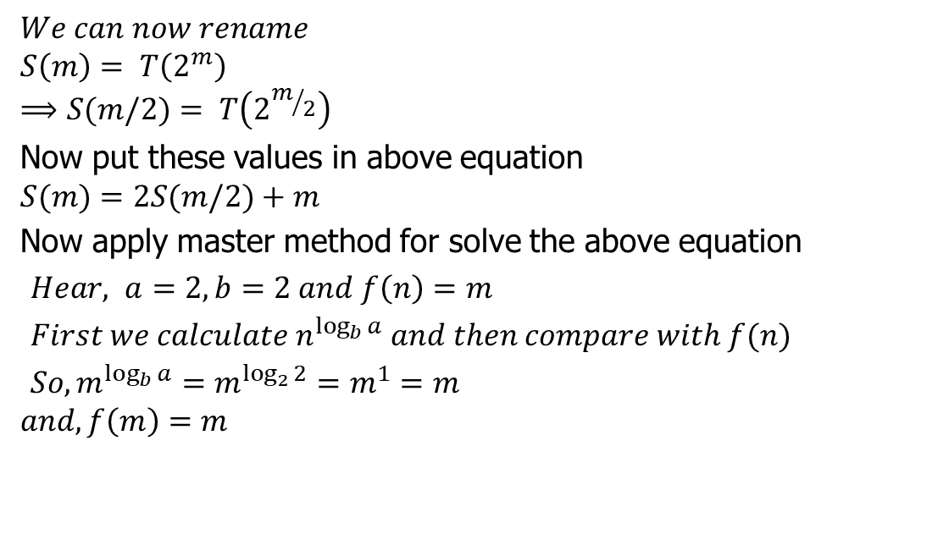
Master Method
$$We can now rename$$
$$S\left(m\right)= T\left(2^{m}\right)$$
$$⟹S(m/2)= T\left(2^{m/2}\right)$$
Now put these values in above equation
$$S(m)=2S(m/2)+m$$
Now apply master method for solve the above equation
$Hear, a=2, b=2 and f\left(n\right)=m$
$First we calculate n^{\log_{b}{a}} and then compare with f(n)$
$So, m^{\log_{b}{a}}=m^{\log_{2}{2}}=m^{1}=m$
$$and, f\left(m\right)=m$$

Slide 25
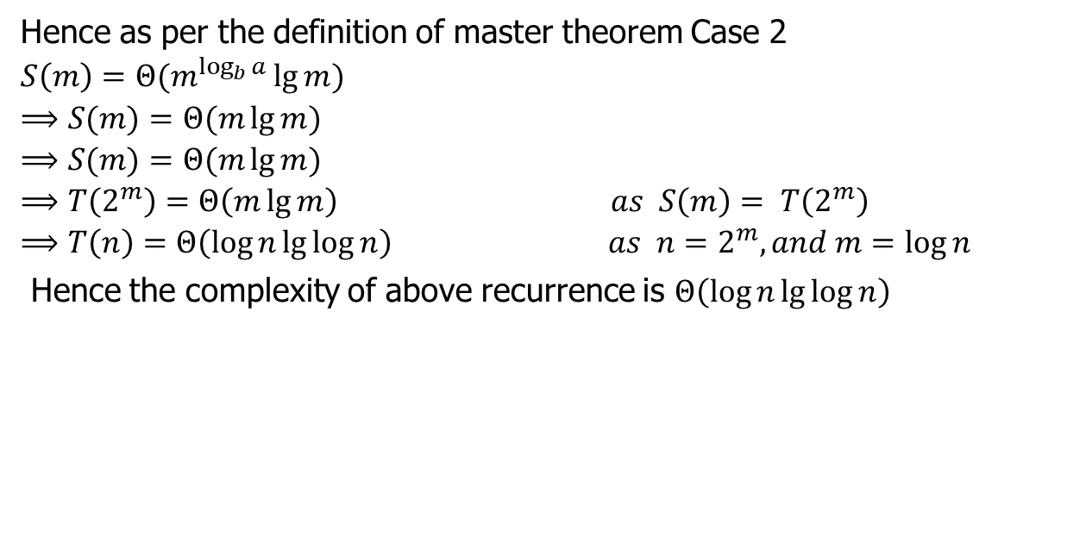
Master Method
Hence as per the definition of master theorem Case 2
$$S\left(m\right)={Θ(m}^{\log_{b}{a}}\lg{m})$$
$$⟹S(m)=Θ(m\lg{m})$$
$$⟹S(m)=Θ(m\lg{m})$$
$$⟹T\left(2^{m}\right)=Θ\left(m\lg{m}\right) as S\left(m\right)= T\left(2^{m}\right)$$
$$⟹T\left(n\right)=Θ\left(\log{n}\lg{\log{n}}\right) as n=2^{m}, and m=\log{n}$$
Hence the complexity of above recurrence is $Θ\left(\log{n}\lg{\log{n}}\right)$

Slide 26

Master Method
Example 9
Solve the following recurrence by using Master Method
$$T\left(n\right)=2T(\left\lfloor \sqrt{n}\right\rfloor )+1$$

Slide 27
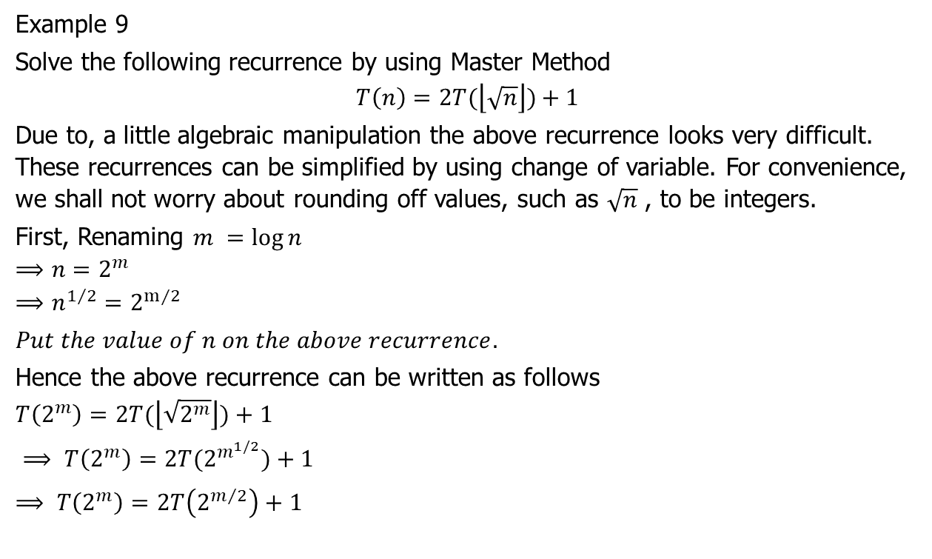
Master Method
Example 9
Solve the following recurrence by using Master Method
$$T\left(n\right)=2T(\left\lfloor \sqrt{n}\right\rfloor )+1$$
Due to, a little algebraic manipulation the above recurrence looks very difficult. These recurrences can be simplified by using change of variable. For convenience, we shall not worry about rounding off values, such as $\sqrt{n}$ , to be integers.
First, Renaming $m =\log{n}$
$$⟹n=2^{m}$$
$$⟹n^{1/2}=2^{m⁄2}$$
$Put the value of n on the above recurrence.$
Hence the above recurrence can be written as follows
$$T\left(2^{m}\right)=2T(\left\lfloor \sqrt{2^{m}}\right\rfloor )+1$$
$⟹ T\left(2^{m}\right)=2T(2^{m^{1/2}})+1$
$⟹ T\left(2^{m}\right)=2T\left(2^{m/2}\right)+1$

Slide 28
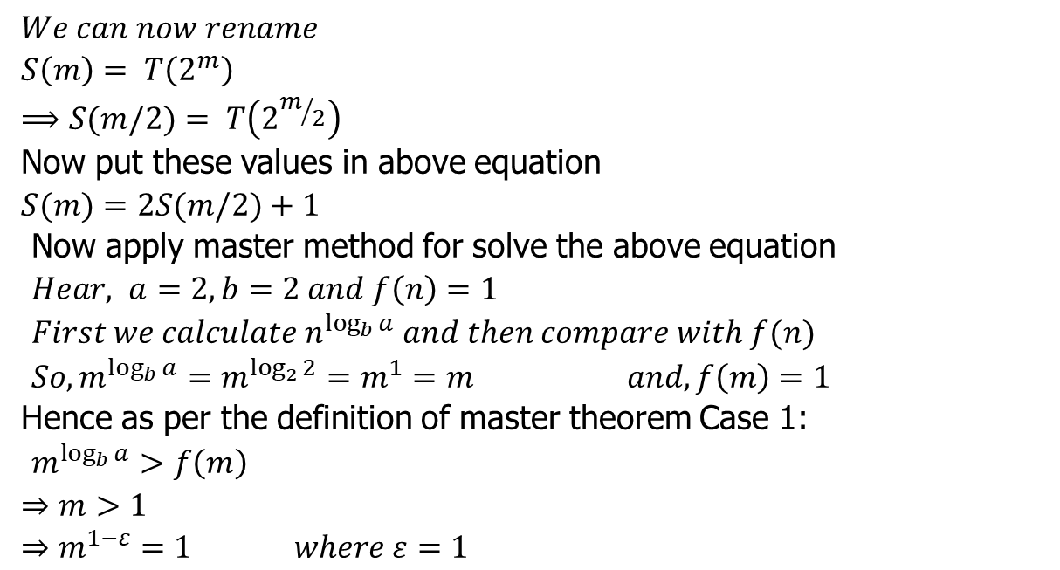
Master Method
$$We can now rename$$
$$S\left(m\right)= T\left(2^{m}\right)$$
$$⟹S(m/2)= T\left(2^{m/2}\right)$$
Now put these values in above equation
$$S(m)=2S(m/2)+1$$
Now apply master method for solve the above equation
$Hear, a=2, b=2 and f\left(n\right)=1$
$First we calculate n^{\log_{b}{a}} and then compare with f(n)$
$So, m^{\log_{b}{a}}=m^{\log_{2}{2}}=m^{1}=m$ $and, f\left(m\right)=1$
Hence as per the definition of master theorem Case 1:
$m^{\log_{b}{a}}>f\left(m\right)$
$⇒m>1$
$$⇒m^{1−ε}=1 where ε=1$$

Slide 29
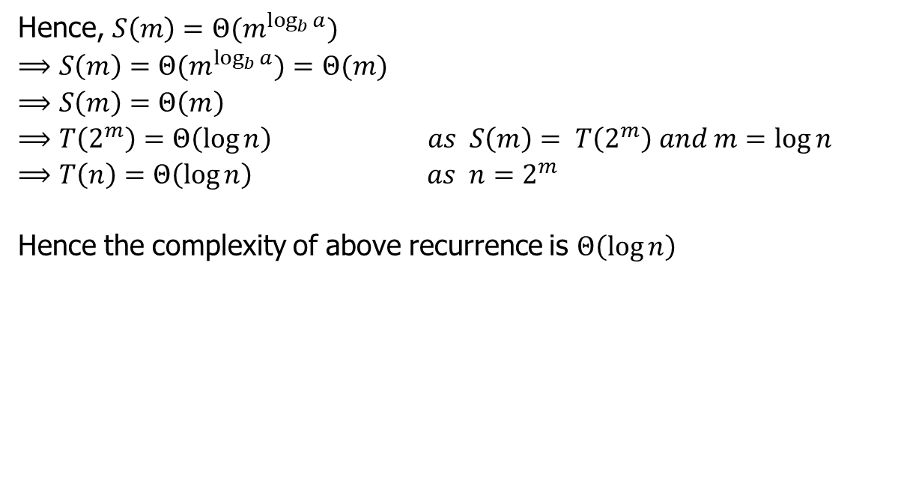
Master Method
Hence, $S\left(m\right)={Θ(m}^{\log_{b}{a}})$
$$⟹S\left(m\right)={Θ(m}^{\log_{b}{a}})=Θ(m)$$
$$⟹S\left(m\right)=Θ\left(m\right)$$
$$⟹T\left(2^{m}\right)=Θ\left(\log{n}\right) as S\left(m\right)= T\left(2^{m}\right) and m=\log{n}$$
$$⟹T\left(n\right)=Θ\left(\log{n}\right) as n=2^{m}$$
Hence the complexity of above recurrence is $Θ\left(\log{n}\right)$

Slide 30
(Solving Recurrence using Advanced version of Master Method) (For GATE questions only)

Slide 31
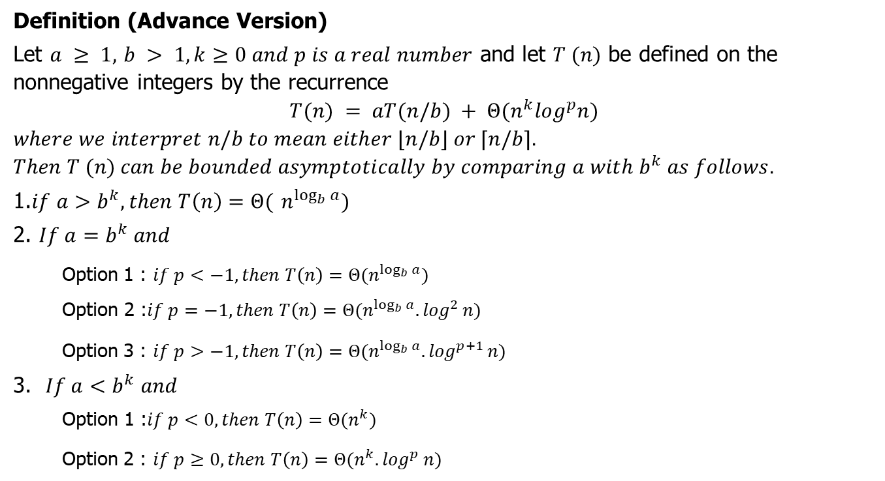
Master Method (GATE)
Definition (Advance Version)
Let $a ≥ 1,$ $b > 1,k≥0 and p is a real number$ and let $T (n)$ be defined on the nonnegative integers by the recurrence
$$T(n) = aT(n/b) + Θ(n^{k}\log^{p}n)$$
$$where we interpret n/b to mean either ⌊n/b⌋ or ⌈n/b⌉.$$
$$Then T (n) can be bounded asymptotically by comparing a with b^{k} as follows.$$
1.$if a>b^{k}, then T\left(n\right)=Θ($ $n^{\log_{b}{a}})$
2. $If a=b^{k} and$
Option 1 : $if p<−1, then T\left(n\right)=Θ(n^{\log_{b}{a}})$
$$\text{Option} \text{2}\text{ :}if p=−1, then T\left(n\right)=Θ(n^{\log_{b}{a}}{.log}^{2}n)$$
Option 3 : $if p>−1, then T\left(n\right)=Θ(n^{\log_{b}{a}}{.log}^{p+1}n)$
3. $If a<b^{k} and$
$$\text{Option}\text{ 1 :}if p<0, then T\left(n\right)=Θ(n^{k})$$
Option 2 : $if p≥0, then T\left(n\right)=Θ(n^{k}{.log}^{p}n)$

Slide 32

Master Method (GATE)
Example 10
Solve the following recurrence by using Master Method
$$T\left(n\right)=3T\left(\frac{n}{2}\right)+{Θ(n}^{2})$$

Slide 33
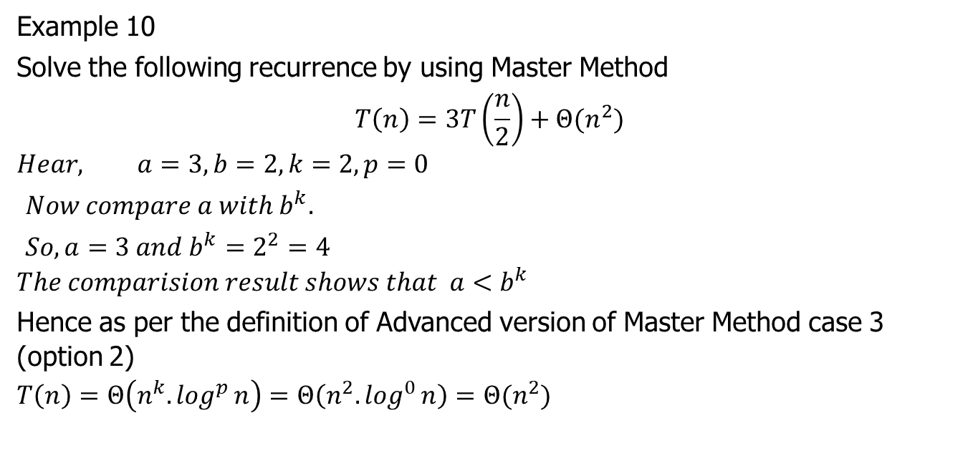
Master Method (GATE)
Example 10
Solve the following recurrence by using Master Method
$$T\left(n\right)=3T\left(\frac{n}{2}\right)+{Θ(n}^{2})$$
$$Hear, a=3, b=2, k=2,p=0$$
$Now compare a with b^{k}.$
$So, a=3 and b^{k}=2^{2}=4$
$$The comparision result shows that a<b^{k}$$
Hence as per the definition of Advanced version of Master Method case 3 (option 2)
$$T\left(n\right)=Θ\left(n^{k}{.log}^{p}n\right)=Θ\left(n^{2}{.log}^{0}n\right)=Θ(n^{2})$$

Slide 34

Master Method (GATE)
Example 11
Solve the following recurrence by using Master Method
$$T\left(n\right)=4T\left(\frac{n}{2}\right)+Θ(n^{2})$$

Slide 35
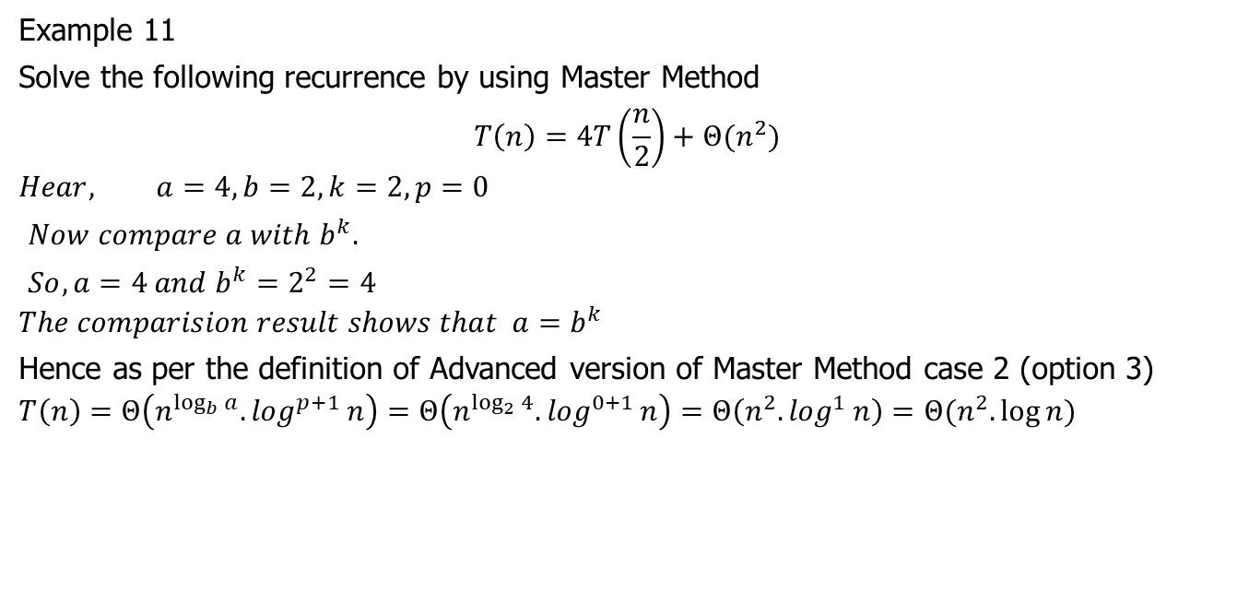
Master Method (GATE)
Example 11
Solve the following recurrence by using Master Method
$$T\left(n\right)=4T\left(\frac{n}{2}\right)+Θ(n^{2})$$
$$Hear, a=4, b=2, k=2,p=0$$
$Now compare a with b^{k}.$
$So, a=4 and b^{k}=2^{2}=4$
$$The comparision result shows that a=b^{k}$$
Hence as per the definition of Advanced version of Master Method case 2 (option 3)
$$T\left(n\right)=Θ\left(n^{\log_{b}{a}}{.log}^{p+1}n\right)=Θ\left(n^{\log_{2}{4}}{.log}^{0+1}n\right)=Θ\left(n^{2}{.log}^{1}n\right)=Θ(n^{2}.\log{n})$$

Slide 36

Master Method (GATE)
Example 12
Solve the following recurrence by using Master Method
$$T\left(n\right)=T\left(\frac{n}{2}\right)+Θ(n^{2})$$

Slide 37
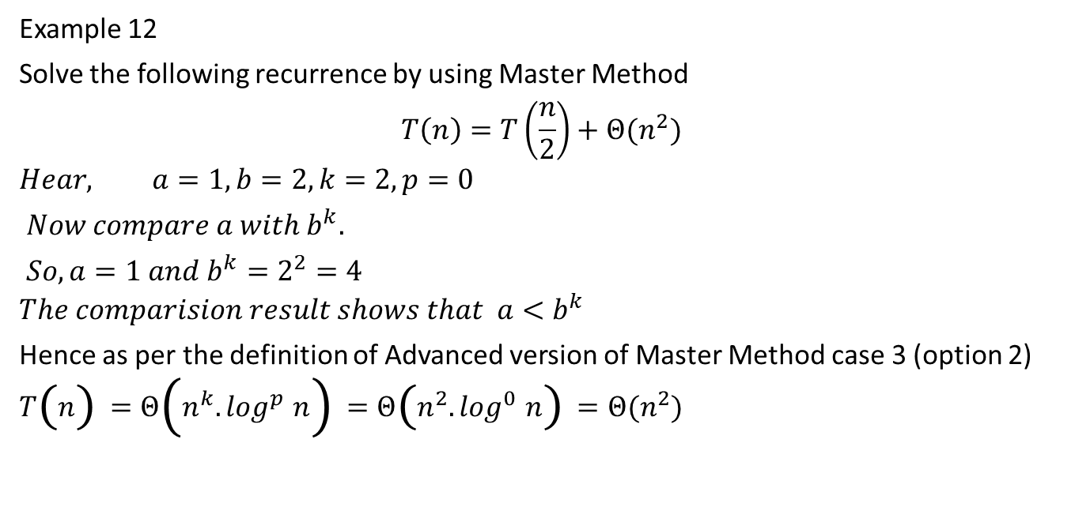
Master Method (GATE)
Example 12
Solve the following recurrence by using Master Method
$$T\left(n\right)=T\left(\frac{n}{2}\right)+Θ(n^{2})$$
$$Hear, a=1, b=2, k=2,p=0$$
$Now compare a with b^{k}.$
$So, a=1 and b^{k}=2^{2}=4$
$$The comparision result shows that a<b^{k}$$
Hence as per the definition of Advanced version of Master Method case 3 (option 2)
$$T\left(n\right)=Θ\left(n^{k}{.log}^{p}n\right)=Θ\left(n^{2}{.log}^{0}n\right)=Θ(n^{2})$$

Slide 38

Master Method (GATE)
Example 13
Solve the following recurrence by using Master Method
$$T\left(n\right)=2^{n}T\left(\frac{n}{2}\right)+{Θ(n}^{n})$$

Slide 39
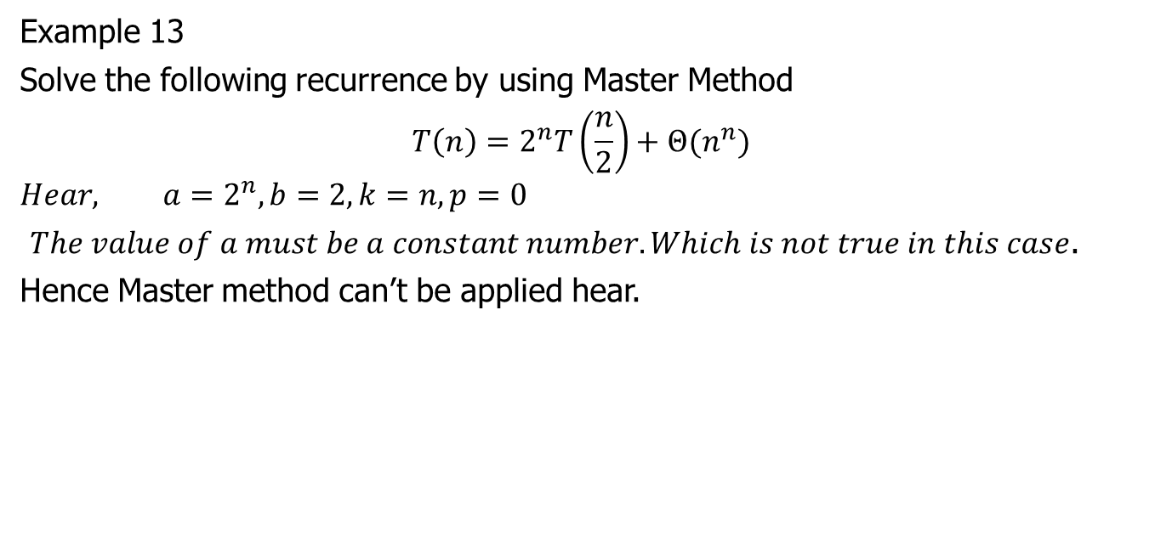
Master Method (GATE)
Example 13
Solve the following recurrence by using Master Method
$$T\left(n\right)=2^{n}T\left(\frac{n}{2}\right)+{Θ(n}^{n})$$
$$Hear, a=2^{n}, b=2, k=n,p=0$$
$The value of a must be a constant number. Which is not true in this case$.
Hence Master method can’t be applied hear.

Slide 40

Master Method (GATE)
Example 14
Solve the following recurrence by using Master Method
$$T\left(n\right)=2T\left(\frac{n}{2}\right)+Θ(n\log{n)}$$

Slide 41
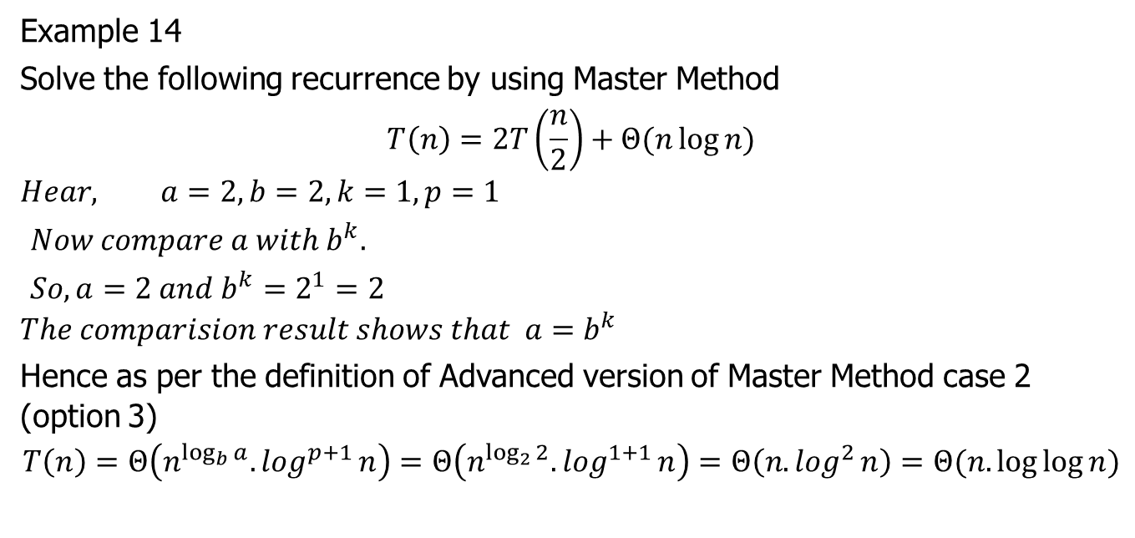
Master Method (GATE)
Example 14
Solve the following recurrence by using Master Method
$$T\left(n\right)=2T\left(\frac{n}{2}\right)+Θ(n\log{n)}$$
$$Hear, a=2, b=2, k=1,p=1$$
$Now compare a with b^{k}.$
$So, a=2 and b^{k}=2^{1}=2$
$$The comparision result shows that a=b^{k}$$
Hence as per the definition of Advanced version of Master Method case 2 (option 3)
$$T\left(n\right)=Θ\left(n^{\log_{b}{a}}{.log}^{p+1}n\right)=Θ\left(n^{\log_{2}{2}}{.log}^{1+1}n\right)=Θ\left(n{.log}^{2}n\right)=Θ(n.\log{\log{n}})$$

Slide 42

Master Method (GATE)
Example 15
Solve the following recurrence by using Master Method
$$T\left(n\right)=2T\left(\frac{n}{2}\right)+Θ\left(\frac{n}{\log{n}}\right)$$

Slide 43

Master Method (GATE)
Example 15
Solve the following recurrence by using Master Method
$$T\left(n\right)=2T\left(\frac{n}{2}\right)+Θ\left(\frac{n}{\log{n}}\right)$$

Slide 44
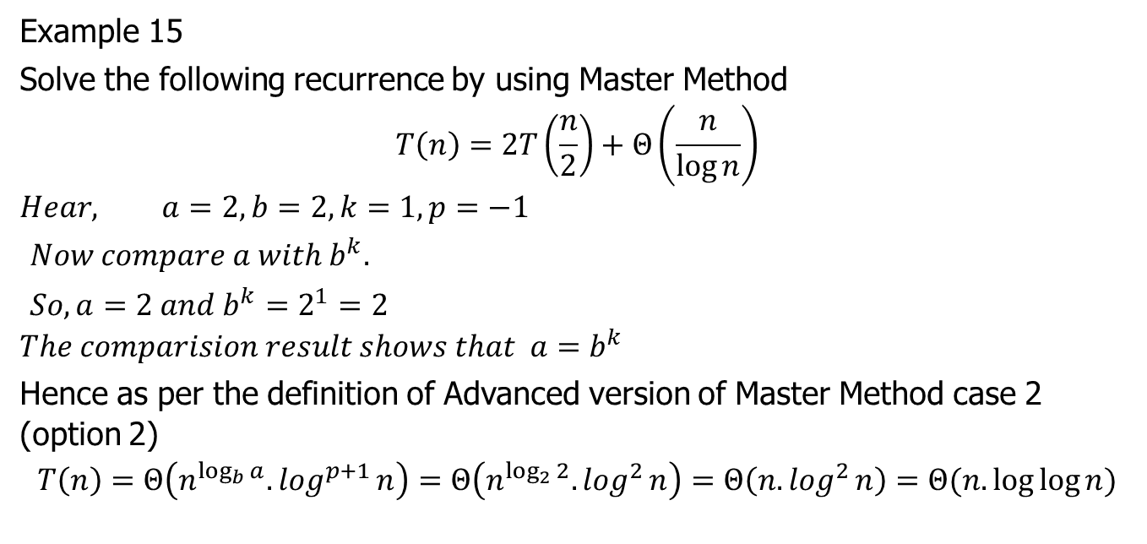
Master Method (GATE)
Example 15
Solve the following recurrence by using Master Method
$$T\left(n\right)=2T\left(\frac{n}{2}\right)+Θ\left(\frac{n}{\log{n}}\right)$$
$$Hear, a=2, b=2, k=1,p=−1$$
$Now compare a with b^{k}.$
$So, a=2 and b^{k}=2^{1}=2$
$$The comparision result shows that a=b^{k}$$
Hence as per the definition of Advanced version of Master Method case 2 (option 2)
$$T\left(n\right)=Θ\left(n^{\log_{b}{a}}{.log}^{p+1}n\right)=Θ\left(n^{\log_{2}{2}}{.log}^{2}n\right)=Θ\left(n{.log}^{2}n\right)=Θ(n.\log{\log{n}})$$

Slide 45

Master Method (GATE)
Example 16
Solve the following recurrence by using Master Method
$$T\left(n\right)=2T\left(\frac{n}{4}\right)+{Θ(n}^{0.51})$$

Slide 46
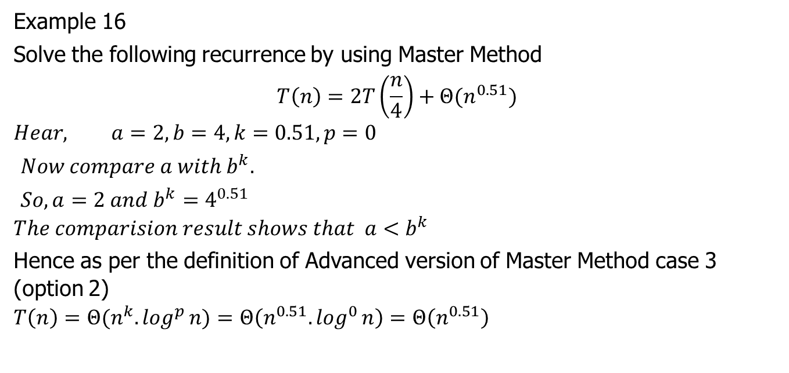
Master Method (GATE)
Example 16
Solve the following recurrence by using Master Method
$$T\left(n\right)=2T\left(\frac{n}{4}\right)+{Θ(n}^{0.51})$$
$$Hear, a=2, b=4, k=0.51,p=0$$
$Now compare a with b^{k}.$
$So, a=2 and b^{k}=4^{0.51}$
$$The comparision result shows that a<b^{k}$$
Hence as per the definition of Advanced version of Master Method case 3 (option 2)
$$T\left(n\right)=Θ(n^{k}{.log}^{p}n)=Θ\left(n^{0.51}{.log}^{0}n\right)=Θ\left(n^{0.51}\right)$$

Slide 47

Master Method (GATE)
Example 17
Solve the following recurrence by using Master Method
$$T\left(n\right)=0.5T\left(\frac{n}{2}\right)+\frac{1}{n}$$

Slide 48
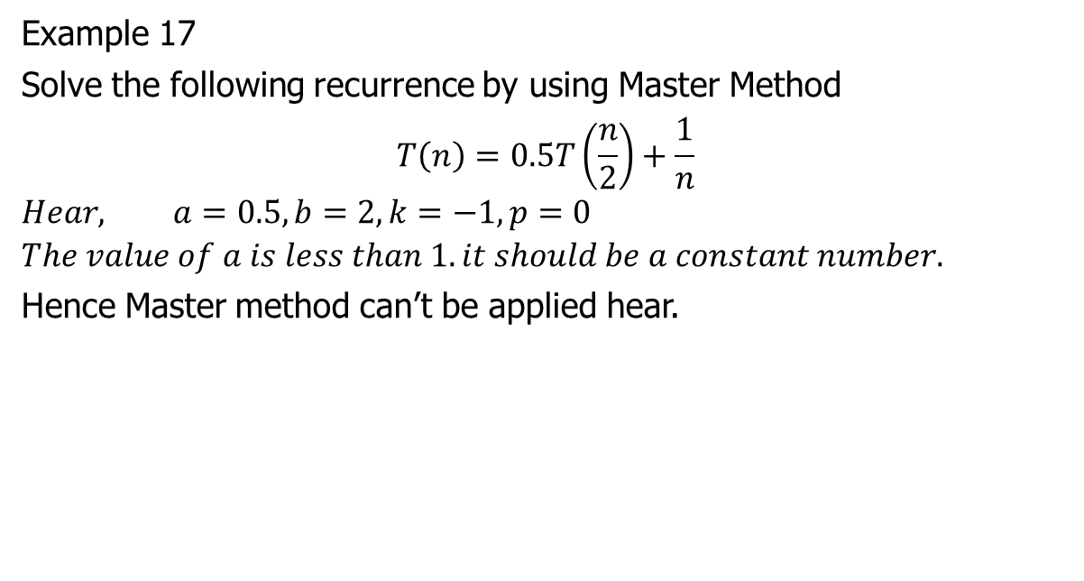
Master Method (GATE)
Example 17
Solve the following recurrence by using Master Method
$$T\left(n\right)=0.5T\left(\frac{n}{2}\right)+\frac{1}{n}$$
$$Hear, a=0.5, b=2, k=−1,p=0$$
$$The value of a is less than 1. it should be a constant number.$$
Hence Master method can’t be applied hear.

Slide 49

Master Method (GATE)
Example 18
Solve the following recurrence by using Master Method
$$T\left(n\right)=6T\left(\frac{n}{3}\right)+{Θ(n}^{2}\log{n)}$$

Slide 50
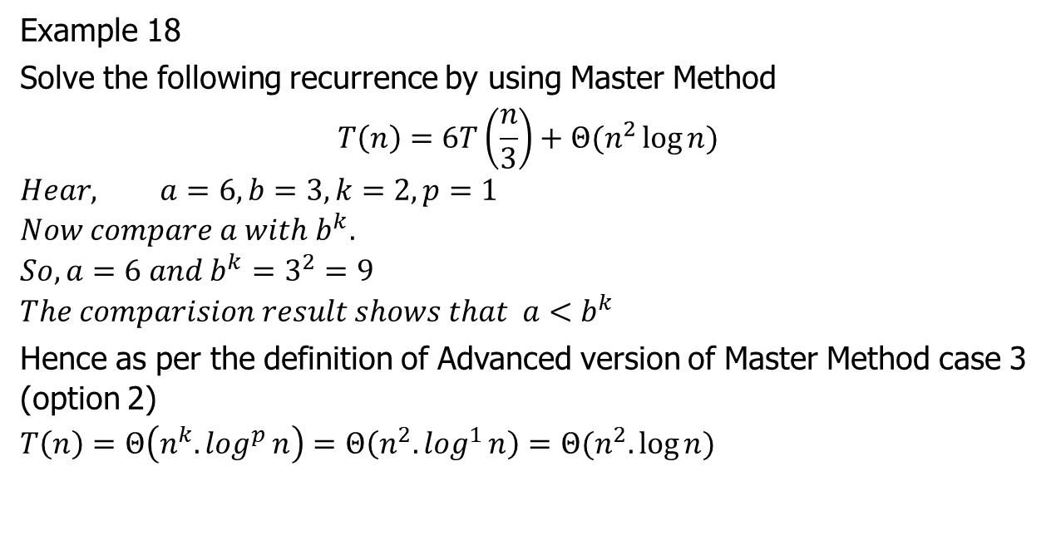
Master Method (GATE)
Example 18
Solve the following recurrence by using Master Method
$$T\left(n\right)=6T\left(\frac{n}{3}\right)+{Θ(n}^{2}\log{n)}$$
$$Hear, a=6, b=3, k=2,p=1$$
$$Now compare a with b^{k}.$$
$$So, a=6 and b^{k}=3^{2}=9$$
$$The comparision result shows that a<b^{k}$$
Hence as per the definition of Advanced version of Master Method case 3 (option 2)
$$T\left(n\right)=Θ\left(n^{k}{.log}^{p}n\right)=Θ\left(n^{2}{.log}^{1}n\right)=Θ(n^{2}.\log{n})$$

Slide 51

Master Method (GATE)
Example 19
Solve the following recurrence by using Master Method
$$T\left(n\right)=64T\left(\frac{n}{8}\right)−{Θ(n}^{2}\lg{n)}$$

Slide 52
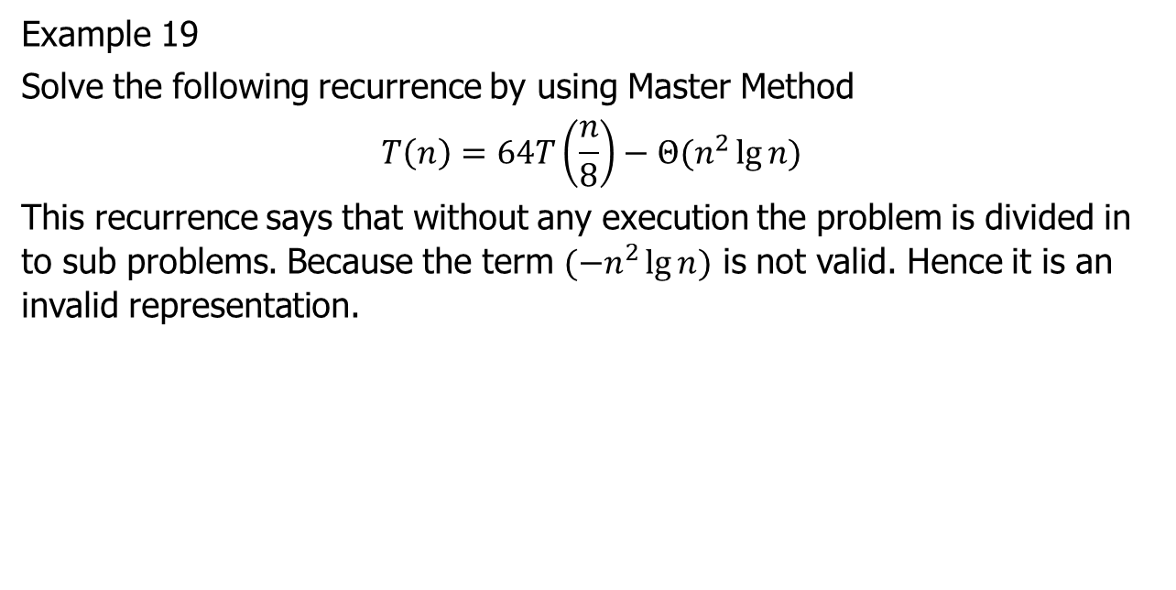
Master Method (GATE)
Example 19
Solve the following recurrence by using Master Method
$$T\left(n\right)=64T\left(\frac{n}{8}\right)−{Θ(n}^{2}\lg{n)}$$
This recurrence says that without any execution the problem is divided in to sub problems. Because the term $(−n^{2}\lg{n})$ is not valid. Hence it is an invalid representation.

Slide 53

Master Method (GATE)
Example 20
Solve the following recurrence by using Master Method
$$T\left(n\right)=4T\left(\frac{n}{3}\right)+Θ(log{n)}$$

Slide 54
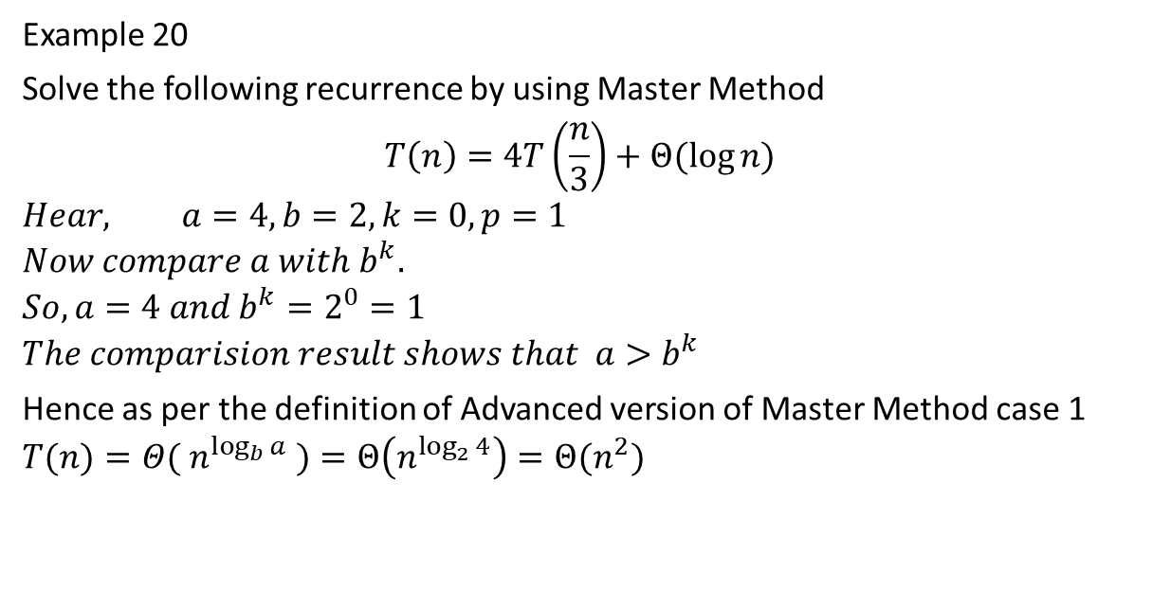
Master Method (GATE)
Example 20
Solve the following recurrence by using Master Method
$$T\left(n\right)=4T\left(\frac{n}{3}\right)+Θ(log{n)}$$
$$Hear, a=4, b=2, k=0,p=1$$
$$Now compare a with b^{k}.$$
$$So, a=4 and b^{k}=2^{0}=1$$
$$The comparision result shows that a>b^{k}$$
Hence as per the definition of Advanced version of Master Method case 1
$$T(n)=Θ( n^{\log_{b}{a}} )=Θ\left(n^{\log_{2}{4}}\right)=Θ(n^{2})$$

Slide 55

Master Method (GATE)
Example 21
Solve the following recurrence by using Master Method
$$T\left(n\right)=27T\left(\frac{n}{3}\right)+Θ\left(n^{3}\lg{n}\right)$$

Slide 56

Master Method (GATE)
Example 21
Solve the following recurrence by using Master Method
$$T\left(n\right)=27T\left(\frac{n}{3}\right)+Θ\left(n^{3}\lg{n}\right)$$
$$Hear, a=27, b=3, k=3,p=1$$
$$Now compare a with b^{k}.$$
$$So, a=27 and b^{k}=3^{3}=1$$
$$The comparision result shows that a=b^{k}$$
Hence as per the definition of Advanced version of Master Method case 2(option 3)
$$T\left(n\right)=Θ\left( n^{\log_{b}{a}} .\log^{p+1}n\right)=Θ\left(n^{\log_{3}{27}} .\log^{1+1}n\right)=Θ\left( n^{2} .\log^{2}n\right)=Θ\left( n^{2} .\log{\log{n}}\right)$$

Slide 57

Thank U

